Slide 1
predicting drug–target binding affinity with graph neural networks
Presented by: Youssef Ezz Eldeen Ezzat
Directed By: Francesc Seratosa

Slide 2
Contents
Introduction to Drug Target Affinity(DTA)
Drug and Protein representation
Affinity measurements
Datasets
Previous work
GraphDTA paper overview
Results

Slide 3
Introduction
A virus encodes one or more proteases which are enzymes that spur the formation of new protein products, thus play crucial roles in virus replication
proteases are important targets for the design and development of potent antiviral agents or drugs

Slide 4
Introduction
Binding affinity is the strength of the binding interaction between a single molecule (e.g., a virus protein) to its ligand or binding partner (e.g., a drug)

Slide 5
Protein representation
A protein sequence is the order of amino acids in a protein. Amino acids are the building blocks of proteins
an example of a protein sequence, representing the first 7 amino acids of the protein insulin (GIVEQCC ...):
G: Glycine
I: Isoleucine
V: Valine
E: Glutamic acid
Q: Glutamine
C: Cysteine
C: Cysteine

Slide 6
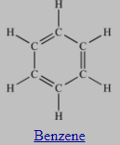
SMILES notation
“Simplified Molecular-Input Line-Entry System”
popular method for specifying molecules with text strings.
invented to represent molecules to be readable by humans and computers
Methane: "C"
Ethanol: "CCO"
Benzene: "c1ccccc1“
Glucose: "OC[C@@H]1OC@HC@@HC@H[C@H]1O"
Notes:
A SMILES string describes the atoms and bonds of a molecule in a way that is both concise and reasonably intuitive to chemists.

Slide 7
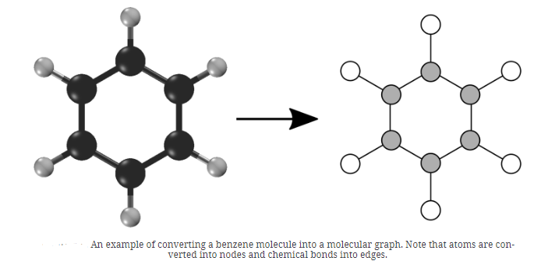
molecular graph
A molecular graph describes the set of atoms in a molecule and how they are bonded together
G = (V,E), where V is the set of N nodes and E is the set of edges represented as an adjacency matrix A
Notes:
Any molecule can be converted into a corresponding molecular graph. in order to analyze them and learn to make predictions about them.
A molecular graph describes the set of atoms in a molecule and how they are bonded together.

Slide 8


binding affinity measures
The kinase dissociation constant(Kd)
measures the equilibrium between the ligand(drug)-protein complex and the dissociated components
Where [P] is the free protein concentration
[L] is the free ligand concentration
[PL] is the protein-ligand complex
Notes:
It corresponds to the affinity which the ligand has for the binding site. Ligands with higher, more favorable free energy of association bind “tighter” and therefore have greater preference for the bound state. Because Kd is defined as a dissociation constant, higher affinity ligands have lower Kd values. As an equilibrium constant, we can express it as the ratio of product concentrations over reactants:
Equilibrium dissociation constant (K_{d})
Definition: A measure of the tendency of a larger complex to separate (dissociate) into its smaller parts. For example, when a protein complex separates into its component proteins, or when a salt splits-up into its component ions. The dissociation reaction can be represented as A_{x}B_{y} ⇄ A_{x} + B_{y} and the equilibrium dissociation constant (K_{d}) is calculated as K_{d} =([A_{x}][B_{y}])/[A_{x}B_{y}] where [A_{x}], [B_{y}], and [A_{x}B_{y}] are the concentrations of each component and the fully formed complex at equilibrium. Relevance: In receptor pharmacology, the dissociation constant is commonly used to describe the affinity between a ligand and its receptor. Therefore, K_{d} can be used as a measure of binding affinity (how tightly a ligand binds to a receptor). The ligand-receptor binding reaction can be represented as L + R ⇄ LR and K_{d} can be calculated as K_{d} =([L][R])/[LR]. In the case of ligand-receptor complexes, K_{d} represents the ligand concentration and should be calculated when 50% of the receptors are bound to ligands. The smaller the K_{d,} the more tightly bound the ligand is and therefore the higher the affinity between the ligand and the receptor.

Slide 9
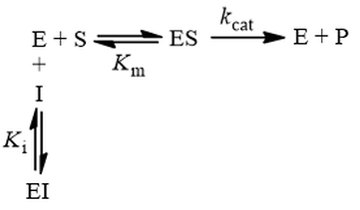
binding affinity measures
The kinase Inhibition Constant(Ki)
represents the affinity of the drug molecule for its target receptor, specifically in the context of competitive inhibition.
Notes:
because the inhibitor “competes” with substrate for binding the active site of the enzyme. By reducing the availability of this site for substrate binding, product formation is hindered.
Inhibitory constant (K_{i})
Definition: The inhibitory constant (K_{i}) is a type of equilibrium dissociation constant (K_{d}) that represents the equilibrium binding affinity for a ligand that reduces the activity of its binding partner. K_{i} represents the concentration at which the inhibitor ligand occupies 50% of the receptor sites when no competing ligand is present. The smaller the K_{i} the greater the binding affinity and the smaller the amount of ligand is needed to inhibit its binding partners activity.
meaning the drug is a more potent inhibitor.
In summary, Ki and Kd are both measures of binding affinity, but they provide different information about the drug-target interaction. Ki is more relevant in the context of competitive inhibition, while Kd is a more general measure of binding strength.
the dissociation term in Kd implies the equilibrium binding dynamics between the ligand and the target, while the inhibition term in Ki implies the potency of the inhibitor in modulating the enzyme's function. Both measures are important in understanding the interactions between ligands and enzymes or proteins, and in the development of effective therapeutic interventions

Slide 10


binding affinity measures
inhibitory concentration 50% (IC50)
the concentration at which the inhibitor causes a 50% inhibition of enzymatic activity
less precise than Ki or Kd
A lower IC50 value indicates a higher affinity of the drug for the receptor
[S] is the concentration of the natural substrate that competes with the inhibitor for binding to the target.
Notes:
Inhibitory constant (K_{i})
Definition: The inhibitory constant (K_{i}) is a type of equilibrium dissociation constant (K_{d}) that represents the equilibrium binding affinity for a ligand that reduces the activity of its binding partner. K_{i} represents the concentration at which the inhibitor ligand occupies 50% of the receptor sites when no competing ligand is present. The smaller the K_{i} the greater the binding affinity and the smaller the amount of ligand is needed to inhibit its binding partners activity.
meaning the drug is a more potent inhibitor.
In summary, Ki and Kd are both measures of binding affinity, but they provide different information about the drug-target interaction. Ki is more relevant in the context of competitive inhibition, while Kd is a more general measure of binding strength.
the dissociation term in Kd implies the equilibrium binding dynamics between the ligand and the target, while the inhibition term in Ki implies the potency of the inhibitor in modulating the enzyme's function. Both measures are important in understanding the interactions between ligands and enzymes or proteins, and in the development of effective therapeutic interventions

Slide 11
Bioactivity values found from ChEMBL for the imatinib-SRC pair
Drug | Type | Value | Units | Target
IMATINIB | Ki | 31000 | nM | SRC
IMATINIB | Kd | 10000 | nM | SRC
IMATINIB | IC50 | 100000 | nM | SRC
Making Sense of Large-Scale Kinase Inhibitor Bioactivity Data Sets: A Comparative and Integrative Analysis
, https://pubs.acs.org/doi/10.1021/ci400709d
Notes:
ChEMBL is a publicly available and manually curated database of bioactive drug-like small molecules, their biological targets, and the quantitative drug-target interaction data. It is a valuable resource in the field of drug discovery and development.
Imatinib and SRC (SRC Proto-Oncogene, Non-Receptor Tyrosine Kinase) form an important drug-target pair in the field of cancer research and treatment.

Slide 12
Datasets
Benchmark dataset davis
Benchmark dataset kiba
In house dataset URV

Slide 13
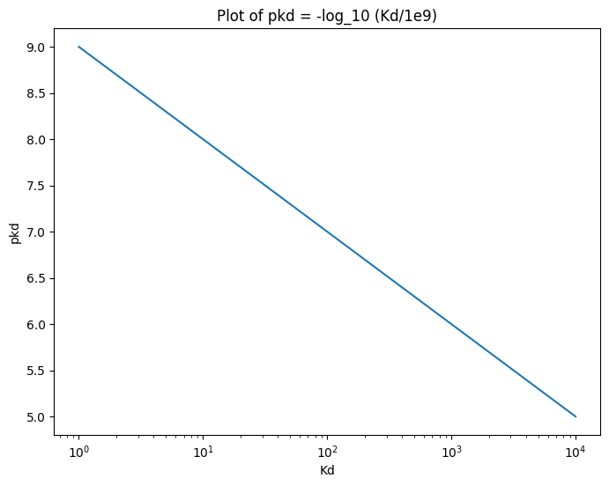

Datasets
Benchmark dataset davis
Kd values in the Davis dataset were transformed into logspace (pKd) as: $pkd={−log}_{10}({Kd}/{1e9})$
ranging from 5.0 to 10.8
Notes:
The kinase dissociation constant, often denoted as Kd, is a measure of the strength of the interaction between a kinase enzyme and its substrate or inhibitor. It represents the concentration of the substrate or inhibitor at which the kinase enzyme is half-saturated.
Specifically, the kinase dissociation constant is defined as:
Kd = [Enzyme] × [Substrate] / [Enzyme-Substrate Complex]
Where:
[Enzyme] is the concentration of the free, unbound kinase enzyme
[Substrate] is the concentration of the free, unbound substrate
[Enzyme-Substrate Complex] is the concentration of the enzyme-substrate complex
A lower Kd value indicates a stronger binding affinity between the kinase and its substrate or inhibitor. A high-affinity interaction has a low Kd, while a low-affinity interaction has a high Kd.

Slide 14
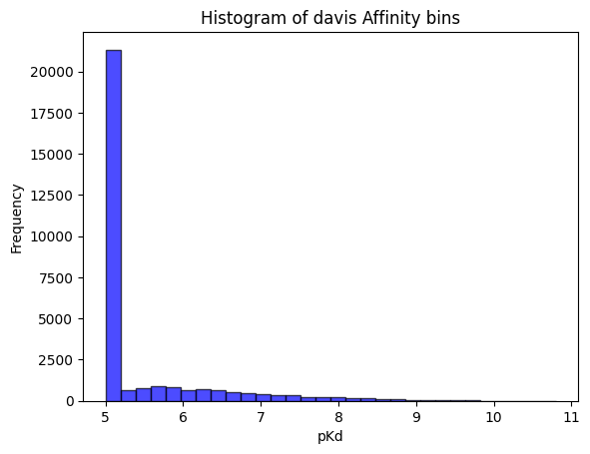
Datasets
Benchmark dataset davis
contains the binding affinities for all pairs of 68 drugs and 442 targets, total of 30056 interactions
25047 train set + 5011 test set
69% of which have affinity values of Kd = 10000 nM (pKd=5) indicating weak or no interaction.
Notes:
The kinase dissociation constant, often denoted as Kd, is a measure of the strength of the interaction between a kinase enzyme and its substrate or inhibitor. It represents the concentration of the substrate or inhibitor at which the kinase enzyme is half-saturated.
Specifically, the kinase dissociation constant is defined as:
Kd = [Enzyme] × [Substrate] / [Enzyme-Substrate Complex]
Where:
[Enzyme] is the concentration of the free, unbound kinase enzyme
[Substrate] is the concentration of the free, unbound substrate
[Enzyme-Substrate Complex] is the concentration of the enzyme-substrate complex
A lower Kd value indicates a stronger binding affinity between the kinase and its substrate or inhibitor. A high-affinity interaction has a low Kd, while a low-affinity interaction has a high Kd.

Slide 15
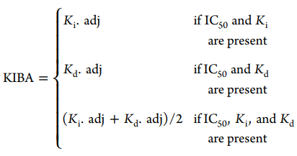
Datasets
Benchmark dataset kiba
Kinase Inhibitor Bioactivity Data Set
binding affinity might be measured by Kd, Ki or IC50
integrates the information from IC50, Ki , and Kd measurements into a single bioactivity score
Notes:
The kinase dissociation constant, often denoted as Kd, is a measure of the strength of the interaction between a kinase enzyme and its substrate or inhibitor. It represents the concentration of the substrate or inhibitor at which the kinase enzyme is half-saturated.
Specifically, the kinase dissociation constant is defined as:
Kd = [Enzyme] × [Substrate] / [Enzyme-Substrate Complex]
Where:
[Enzyme] is the concentration of the free, unbound kinase enzyme
[Substrate] is the concentration of the free, unbound substrate
[Enzyme-Substrate Complex] is the concentration of the enzyme-substrate complex
A lower Kd value indicates a stronger binding affinity between the kinase and its substrate or inhibitor. A high-affinity interaction has a low Kd, while a low-affinity interaction has a high Kd.

Slide 16
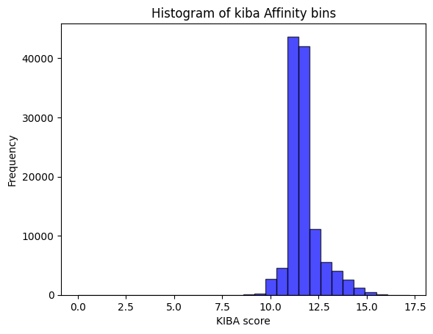
Datasets
Benchmark dataset kiba
measured as KIBA scores and ranging from 0.0 to 17.2
Total of118257 interactions(98547 train set + 19710 test set)
most interactions between 10 and 15 kiba score
Notes:
The kinase dissociation constant, often denoted as Kd, is a measure of the strength of the interaction between a kinase enzyme and its substrate or inhibitor. It represents the concentration of the substrate or inhibitor at which the kinase enzyme is half-saturated.
Specifically, the kinase dissociation constant is defined as:
Kd = [Enzyme] × [Substrate] / [Enzyme-Substrate Complex]
Where:
[Enzyme] is the concentration of the free, unbound kinase enzyme
[Substrate] is the concentration of the free, unbound substrate
[Enzyme-Substrate Complex] is the concentration of the enzyme-substrate complex
A lower Kd value indicates a stronger binding affinity between the kinase and its substrate or inhibitor. A high-affinity interaction has a low Kd, while a low-affinity interaction has a high Kd.

Slide 17
Datasets
In URV-May-2024 database, the URV systematically collected all structures from the Protein Data Bank(PDB) [11] containing the SARS-CoV-2 Mpro protein - also known as the main protease or 3CL protease, is a key enzyme in the replication and transcription of the SARS-CoV-2 virus, which causes COVID-19.
Dataset was refined by selecting structures with available IC50 values from ChEMBL [12] and BindingDB [13] databases, resulting in a final set of 233 structures. For each structure, we obtained the inhibitor’s structure in SDF format, the protein-inhibitor complex in PDB format, and the corresponding IC50 value for Mpro inhibition.

Slide 18
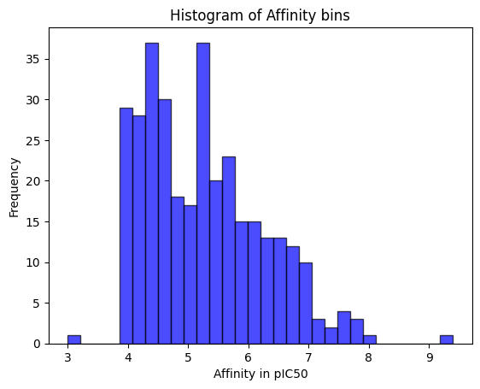
Datasets
IC50 represents the concentration of inhibitor required to inhibit 50% of enzyme activity. Additionally, we transformed IC50 values into pIC50, the negative logarithm (base 10) of the IC50 value, where a higher pIC50 value indicates a more potent inhibitor.

Slide 19
Previous Work
collaborative filtering (2017): utilizes a similarity measure to identify drugs and targets that are similar to the query drug and target. This allows the model to leverage existing data on similar compounds and targets to make predictions for new ones
DeepDTA model (2018): uses a deep neural network architecture with two branches
(CNNs):for capturing local patterns in SMILES notation of drugs
(RNNs):for capturing sequential information in protein sequences.
WideDTA model (2019): uses CNNs to learn complex patterns from both the drug SMILES notation and target protein sequence representations.

Slide 20
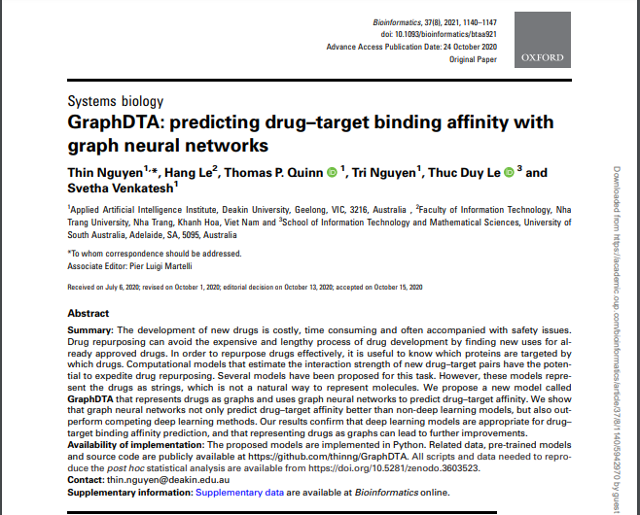
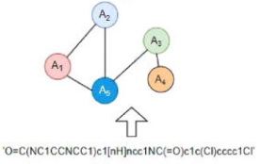
GraphDTA paper overview(2020)
a new neural network architecture capable of directly modeling drugs as molecular graphs
tests the hypothesis that a graph structure could yield a better representation for drugs
outperforms previous deep learning models
Bioinformatics, Volume 37, Issue 8, March 2021, Pages 1140–1147, https://doi.org/10.1093/bioinformatics/btaa921
Notes:
This paper tests the hypothesis that a graph structure could yield a better representation for drugs

Slide 21
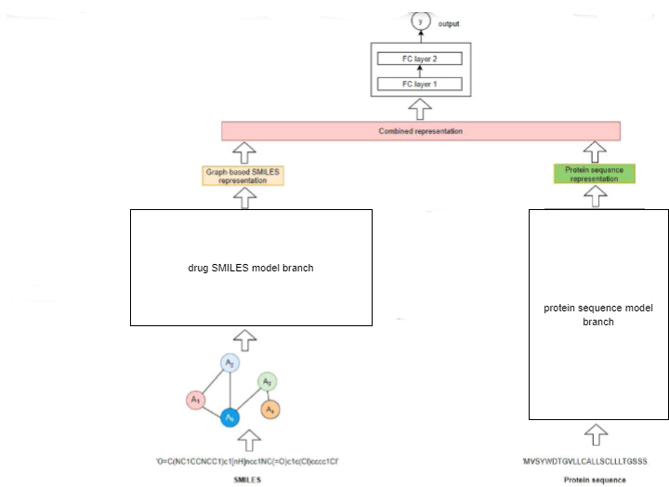
GraphDTA architecture
Protein branch
Drug branch
4 variant models
Combined
representation
Notes:
. This figure shows the GraphDTA architecture. It takes a drug–target pair as the input data, and the pair’s affinity as the output data. It works in three stages. First, the SMILES code of a drug is converted into a molecular graph, and a deep learning algorithm learns a graph representation. Meanwhile, the protein sequence is encoded and embedded, and several 1D convolutional layers learn a sequence representation. Finally, the two representation vectors are concatenated and passed through several fully connected layers to estimate the output drug–target affinity value

Slide 22
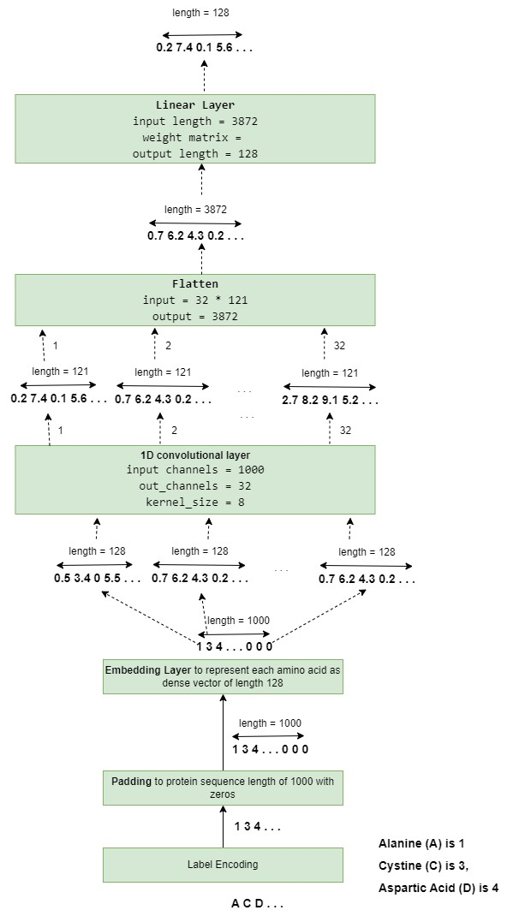
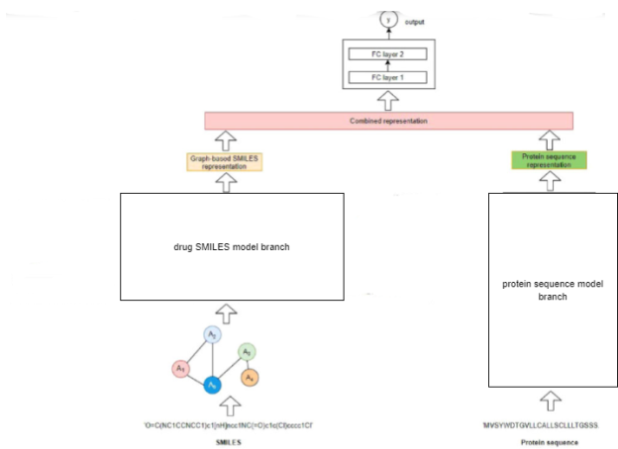
Protein Branch
Notes:
Protein sequence is a string of ASCII characters which represent amino acids. Each amino acid type is encoded with an integer based on its associated alphabetical symbol
[e.g. Alanine (A) is 1, Cystine (C) is 3, Aspartic Acid (D) is 4 and so on]
padded to a fixed length sequence of 1000

Slide 23
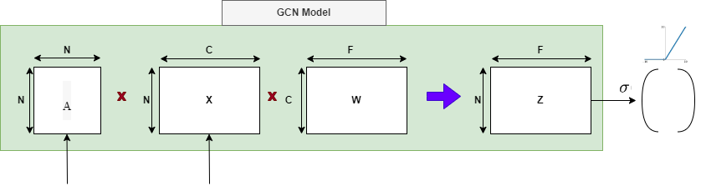
Drug Branch
GCN model
graph convolutional operator from the “Semi-supervised Classification with Graph Convolutional Networks” paper in 2017.
Implemented in torch_geometric as GCNConv
A is the normalized adjacency matrix N * N
X is node feature matrix N * C
W weight matrix of size C * F
Z node-level output matrix N * F

Slide 24
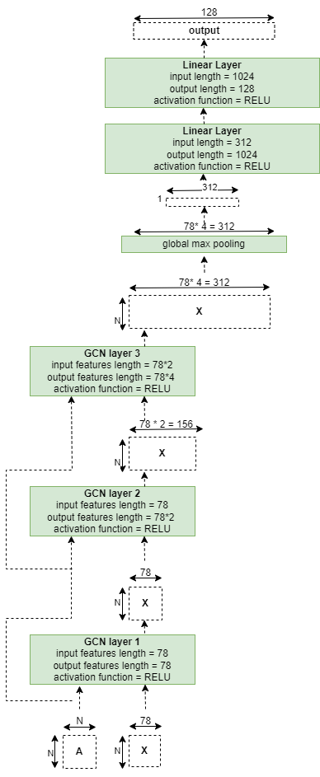

Drug Branch
GCN-based model

Slide 25
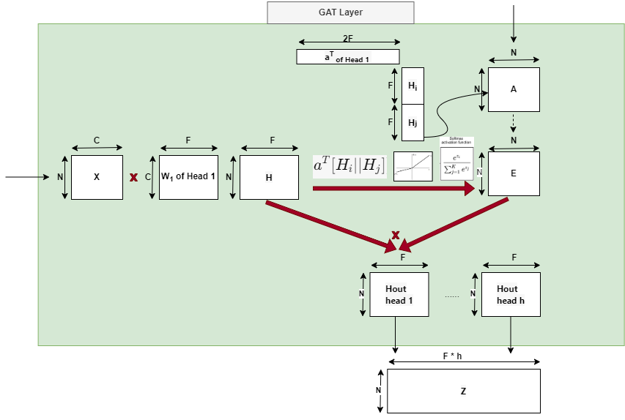
Drug Branch
Graph attention layer(GAT) layer
graph attention Layer from the “Graph Attention Networks” paper in 2018.
Implemented in torch_geometric as GATConv
A : adjacency matrix N * N
X : is node feature matrix N * C
H : transformed feature matrix N * F
W: weight matrix of current head C * F
a : attention vector of current head 2 * F
E : attention score matrix N * N
Z : Final Output Feature Matrix N * F * h

Slide 26
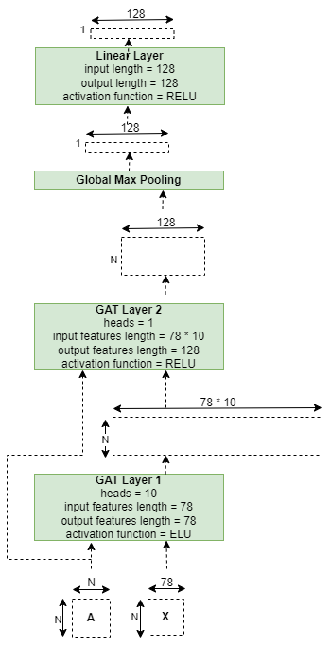
Drug Branch
GAT-based model

Slide 27
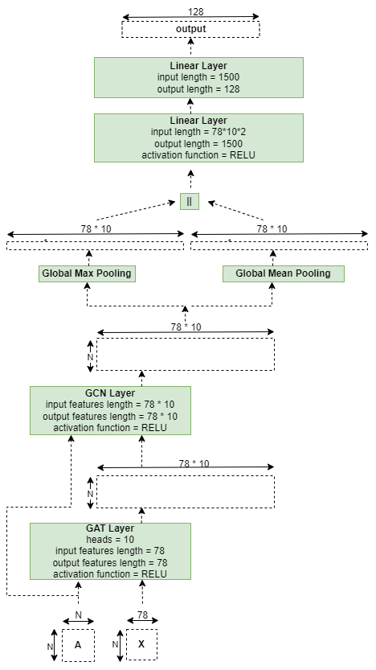
Drug Branch
GAT GCN-based model

Slide 28
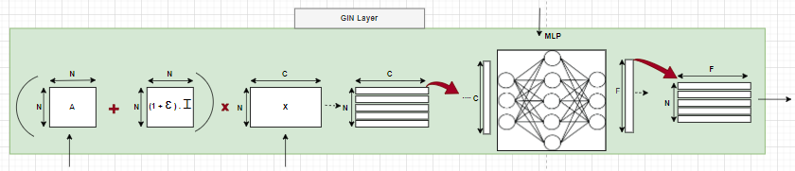
Drug Branch
Graph isomorphic network(GIN) layer
graph attention Layer from the “How Powerful are Graph Neural Networks?” paper in 2019.
Implemented in torch_geometric as GINConv
A : adjacency matrix N * N
X : is node feature matrix N * C
Z : Final Output Feature Matrix N * F

Slide 29
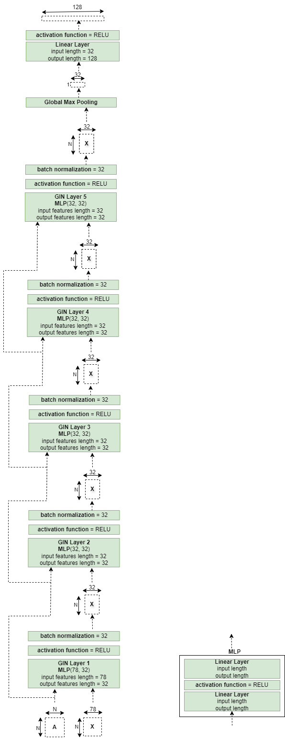
Drug Branch
GIN-based model

Slide 30
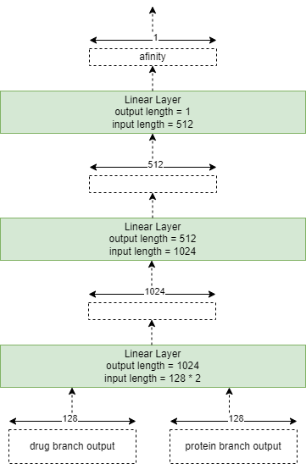
Combined fully connected layers

Slide 31
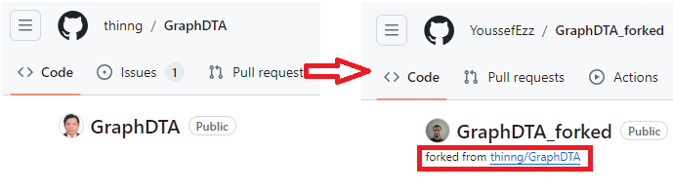
Contribution
Fork the GraphDTA code repository
Refactor and debug the code
Train the proposed 4 models on 3 datasets
Plot and compare the resulting MSEs

Slide 32
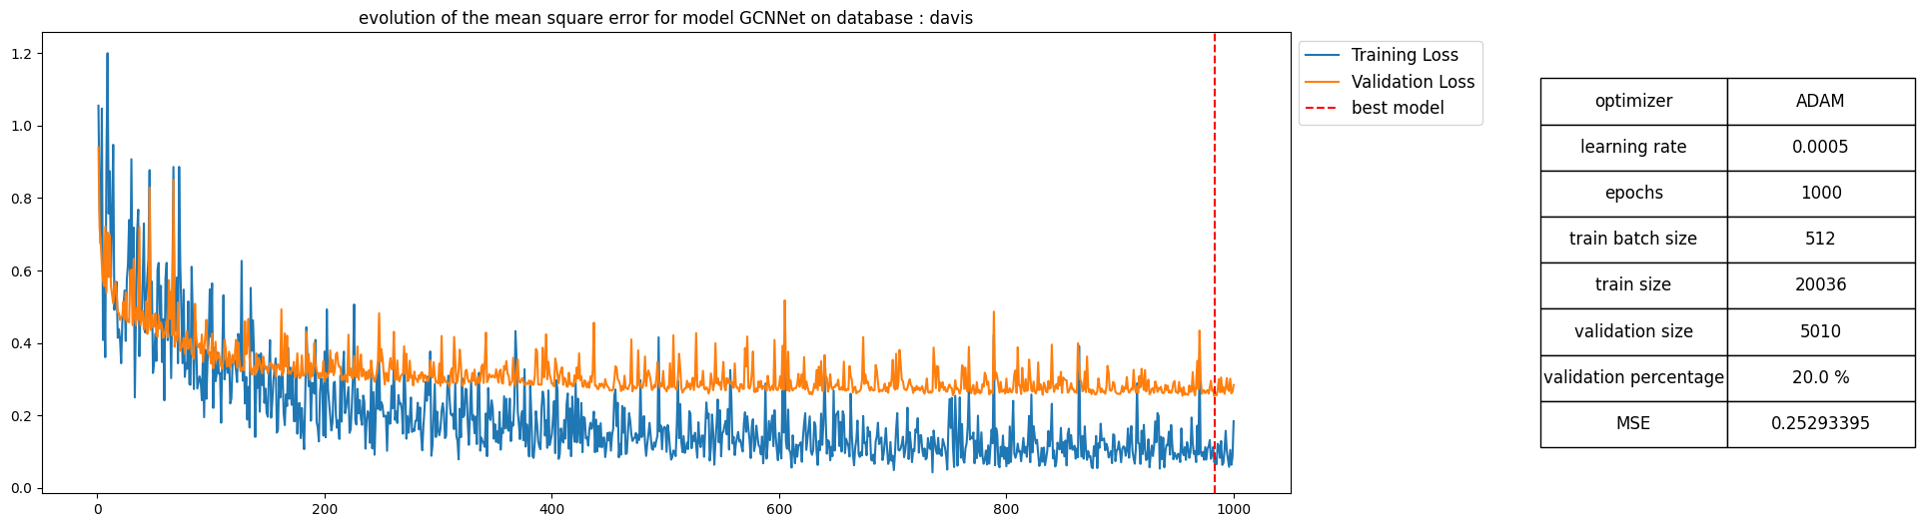
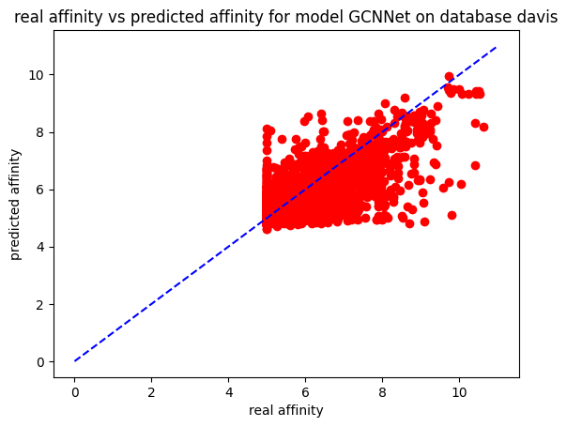
Results
train and test GCN-based model with davis dataset

Slide 33
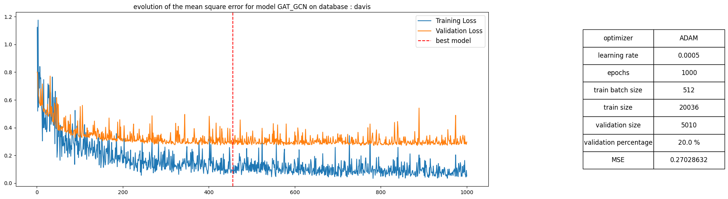
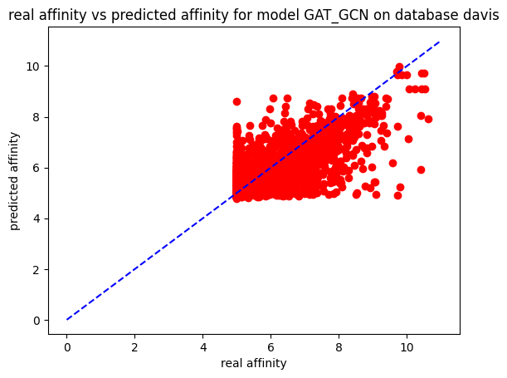
Results
train and test GATGCN-based model with davis dataset

Slide 34
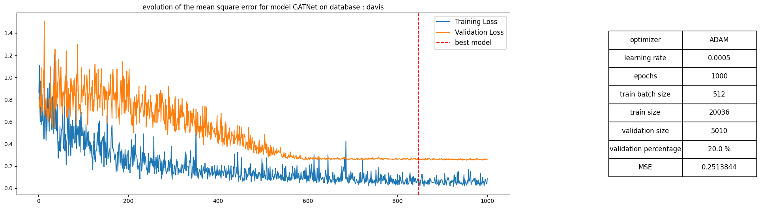
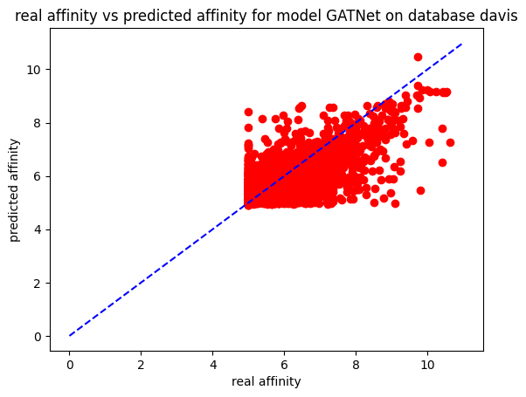
Results
train and test GAT-based model with davis dataset

Slide 35
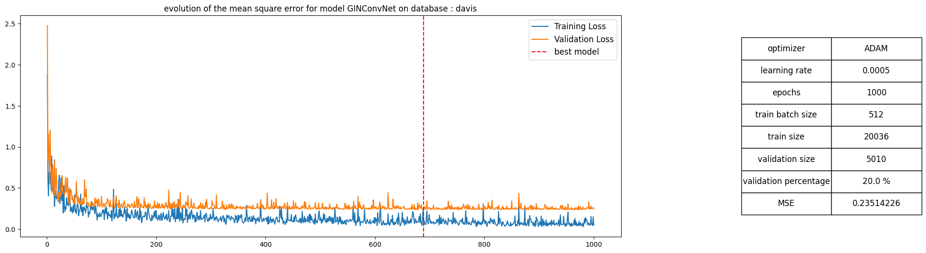

Results
train and test GinConv-based model with davis dataset

Slide 36
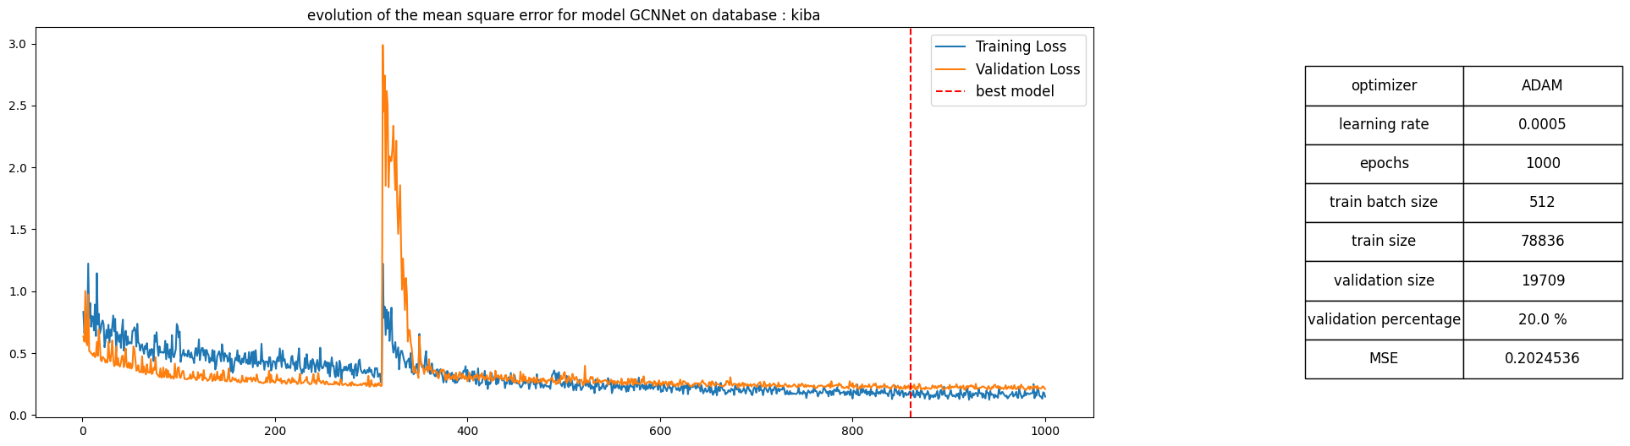
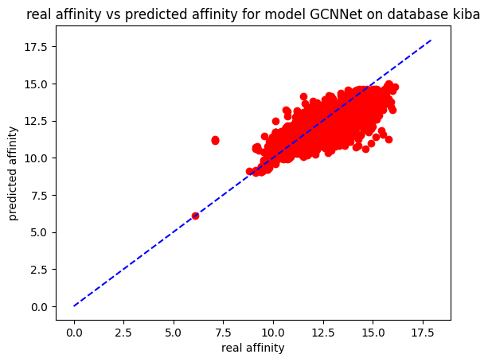
Results
train and test GCN-based model with kiba dataset

Slide 37
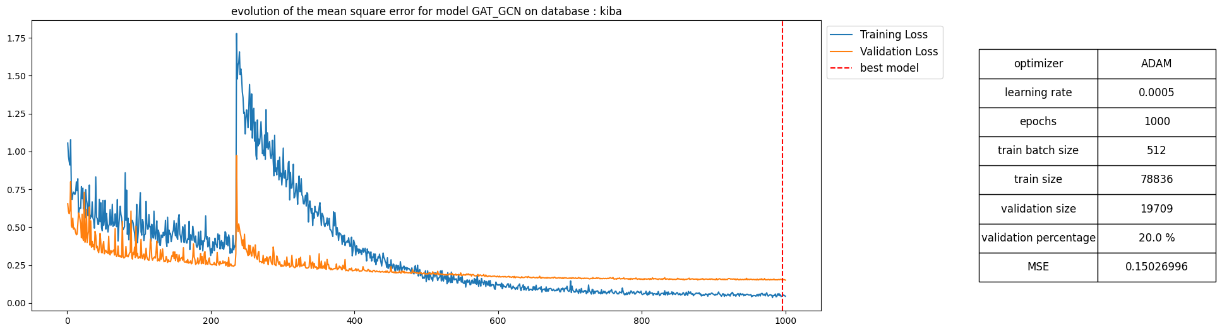
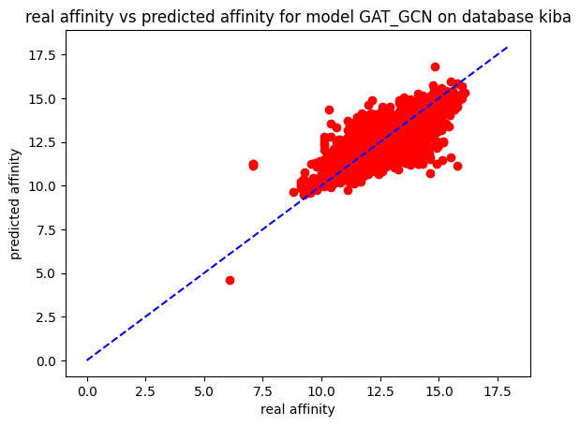
Results
train and test GATGCN-based model with kiba dataset

Slide 38
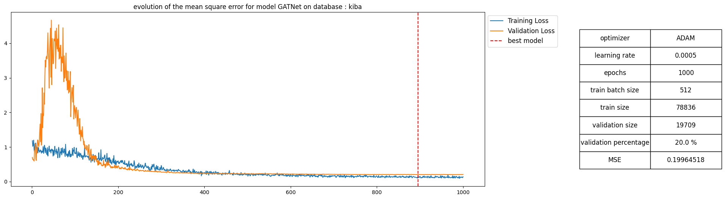
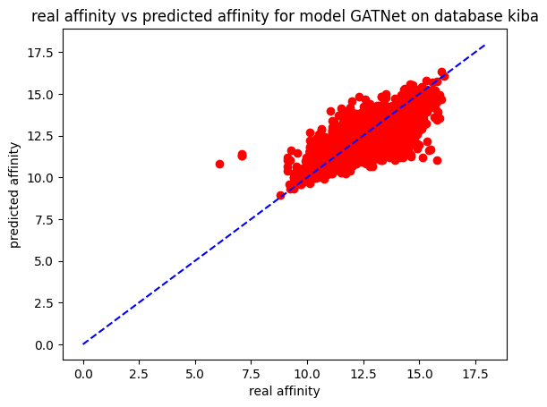
Results
train and test GAT-based model with kiba dataset

Slide 39
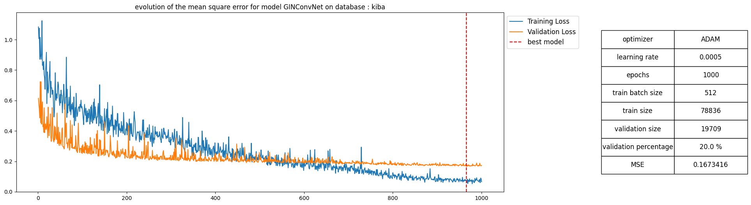
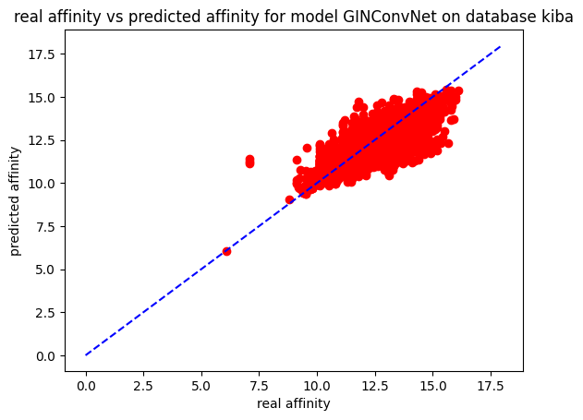
Results
train and test GINCONV-based model with kiba dataset

Slide 40
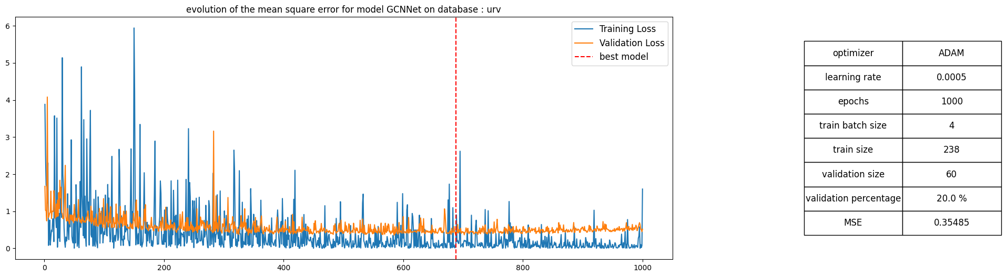
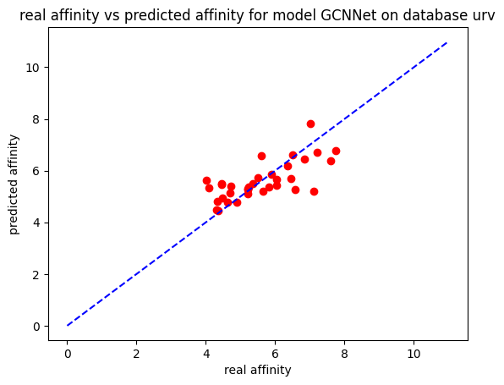
Results
train and test GCN-based model with URV dataset

Slide 41
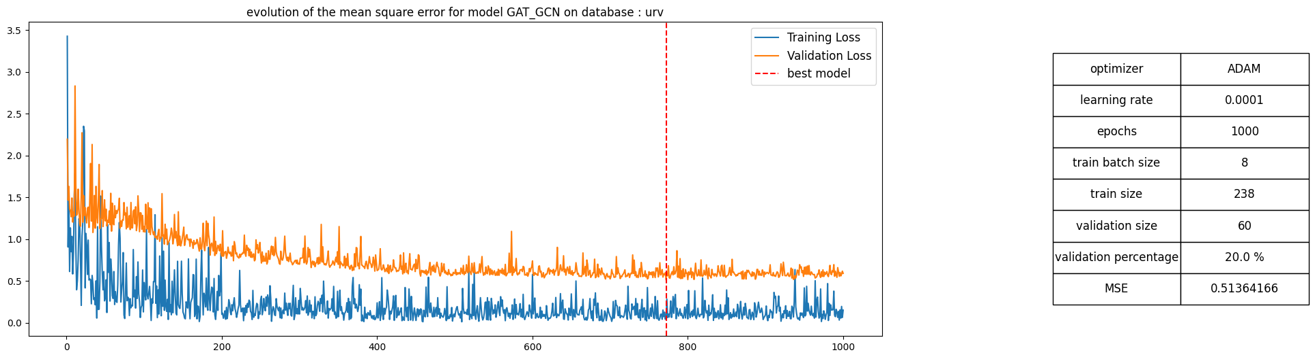
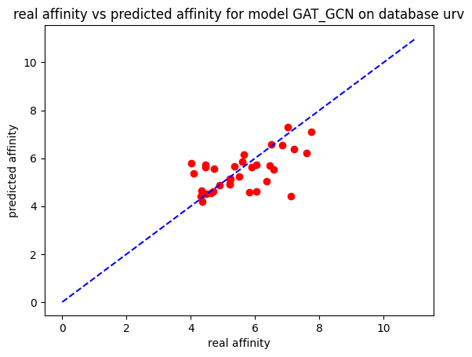
Results
train and test GATGCN-based model with URV dataset

Slide 42
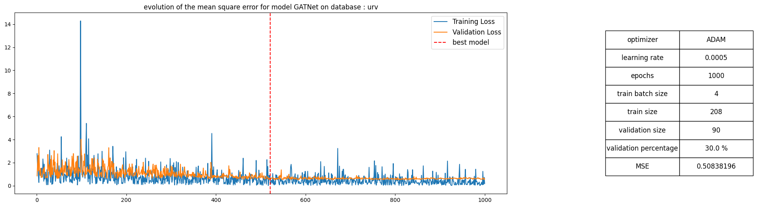
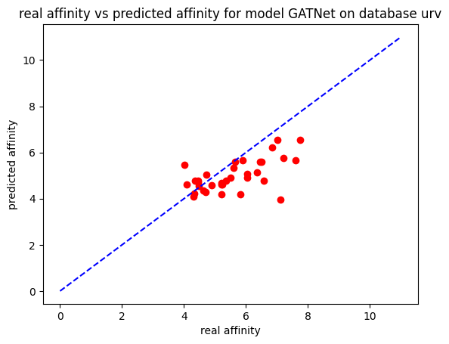
Results
train and test GAT-based model with URV dataset

Slide 43
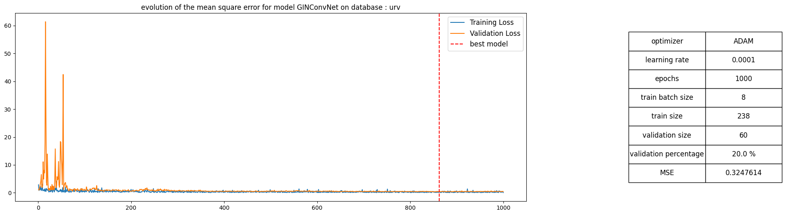
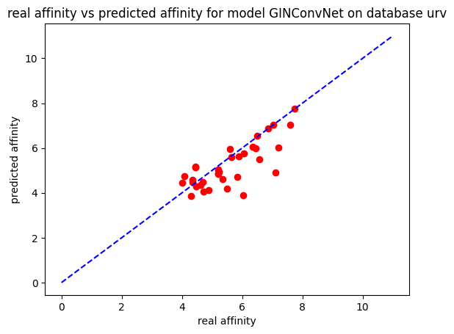
Results
train and test GINCONV-based model with URV dataset

Slide 44
Summary of results
model | dataset | MSE in paper | MSE obtained
GCN-based | davis | 0.254 | 0.25
GATGCN-based | davis | 0.245 | 0.27
GAT-based | davis | 0.232 | 0.25
GINCONV-based | davis | 0.229 | 0.24
GCN-based | kiba | 0.179 | 0.2
GATGCN-based | kiba | 0.147 | 0.15
GAT-based | kiba | 0.139 | 0.2
GINCONV-based | kiba | 0.139 | 0.17
GCN-based | URV | - | 0.35
GATGCN-based | URV | - | 0.51
GAT-based | URV | - | 0.51
GINCONV-based | URV | - | 0.32

Slide 45
Conclusion
the sample size of the data including train and test sets is largest in kiba then davis followed by URV.
kiba dataset has the best diversity specially for the target proteins as it integrates different bioactivity scores
Notes:
the sample size of the data including train and test sets is largest in kiba then davis followed by URV and this helps the network learn more robust and generalizable patterns, thus make accurate predictions on unseen data..
kiba dataset has the best diversity specially for the target proteins as it integrates different bioactivity scores and this is crucial to train a model capable of generalizing to unseen drug-target pairs.

